Slide 1
Counting Sheep: a thousand years of farming and land use change in Loweswater
Extracts from a talk given at Loweswater by Angus Winchester, 16 December 2008

Slide 2
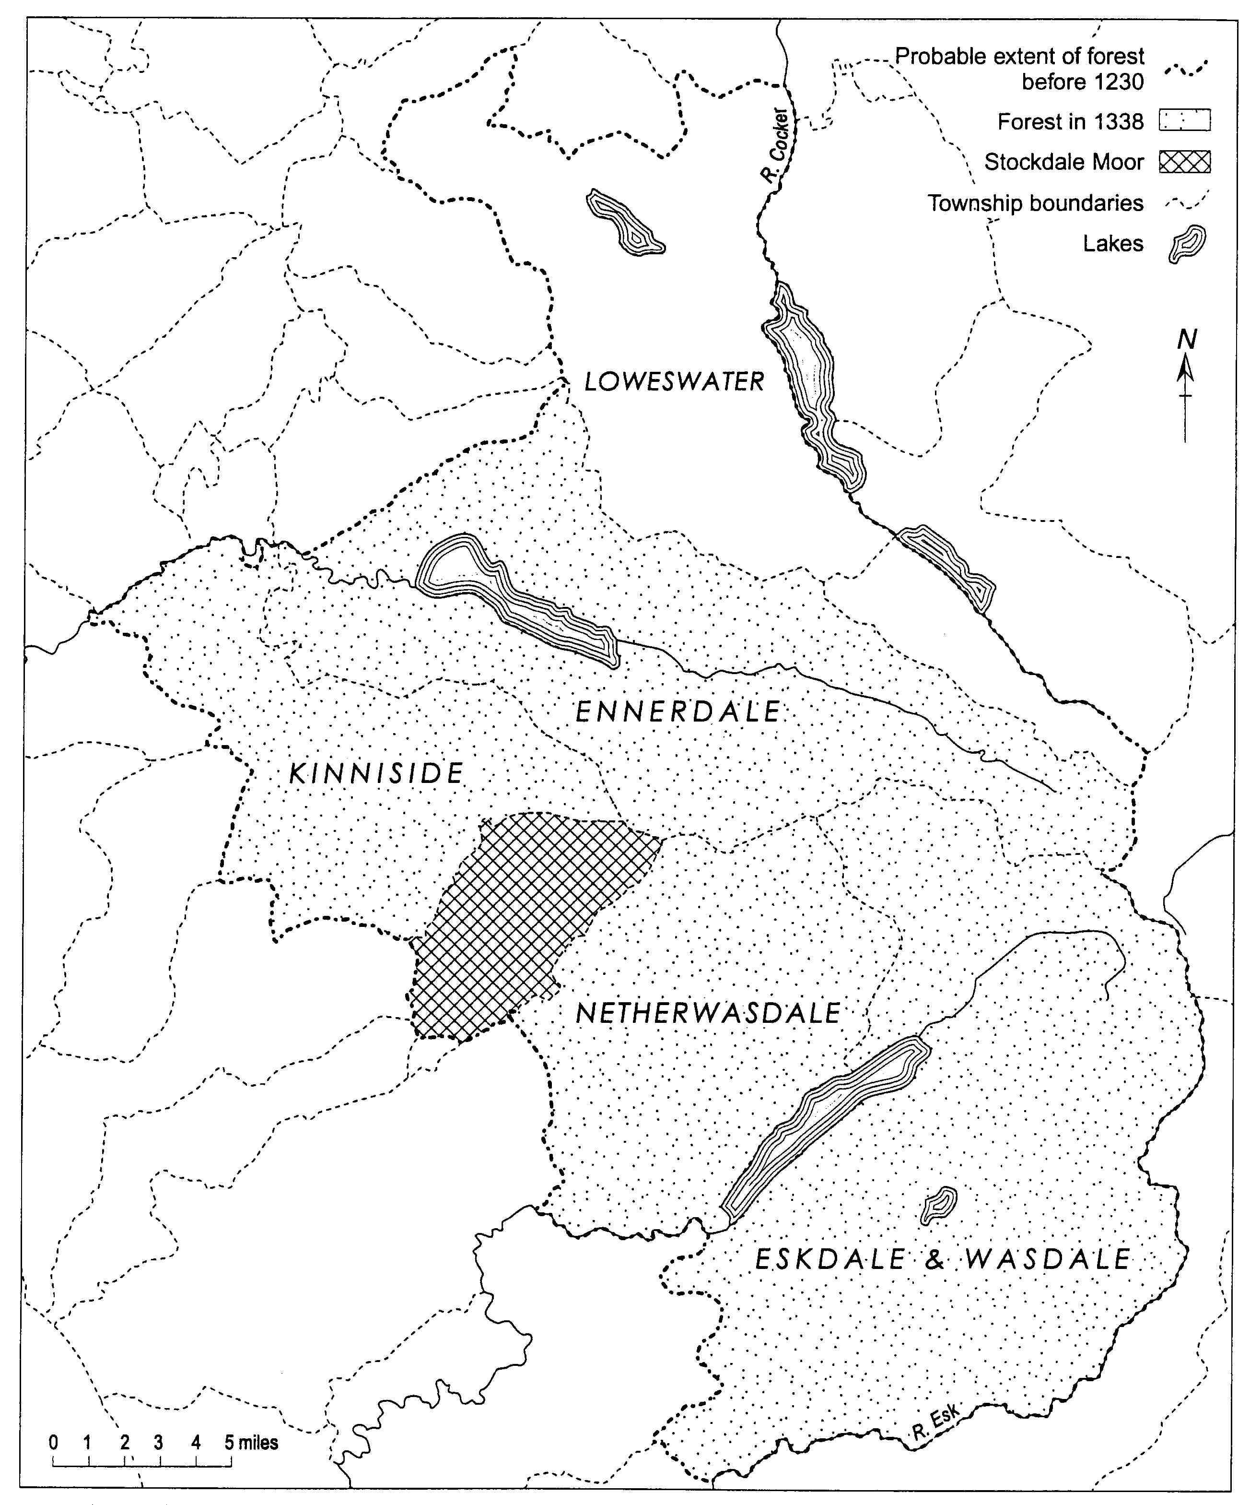
E
E = ‘erg’ place-name
separated from forest 1230
E
E
Hunting forest and summer pastures: Loweswater in relation to Copeland Forest

Slide 3
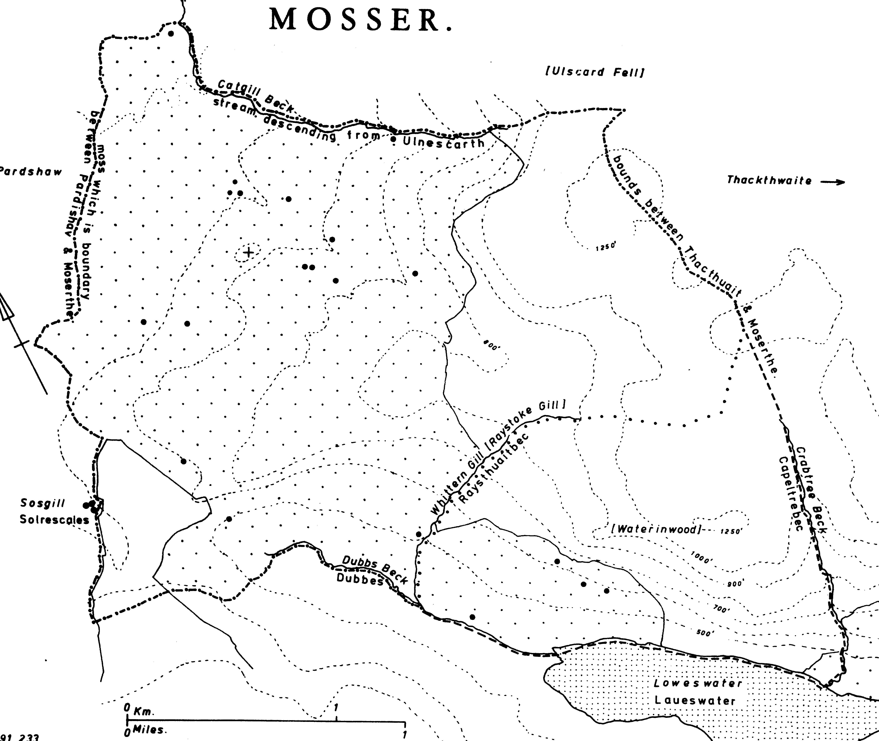
Colonisation, 1150-1300
Mosser (mos-erg) granted c.1200
Dispute over rights in Waterend wood area, 1290
‘Waterend wood’

Slide 4
Two Elizabethan Loweswater farmers
John Wilson, d. Dec. 1592
2 horses, 1 mare
2 oxen
5 kyne
2 ‘whyes’ [heifers]
4 young cattle
3 calves
36 old sheep
19 ‘hodges’ [hoggs]
James Hudson, d. May 1589
1 horse
2 oxen
6 kyne
5 young cattle
85 old sheep
27 lambs

Slide 5
Traditional farming system
Subsistence arable
  Mainly oats (‘havver’); some barley (‘bigg’); little wheat
  Intensively-cultivated home fields; long ley rotations (‘outfield’; ‘leys’)
Meadows
  Hay for winter fodder
  Aftermath (‘fogg’) vital grazing
Cattle
  Small breeding herd; trade in young stock
Sheep
  Wool-producing flock (large proportion of wethers)
  Away-wintering of hoggs

Slide 6
1839 sheep numbers
0
500
In 1839 it was estimated that there were 6,224 sheep in the township, in the hands of 30 owners.
400
300
50
200
100
Proportions in flocks of different sizes
The largest flocks were:
William Simon [Kirkhead]: 1,200
Jonathan Rowlin [Godferhead]: 700
Jonathan Pearson [Park]: 550
Joseph Walker [High Nook]: 500

Slide 7
Loweswater: acreage under crops, 1867-1917
1867 1877 1887 1897 1907 1917

Slide 8
Loweswater: cattle, 1867-1917
1867 1877 1887 1897 1907 1917

Slide 9
Loweswater: sheep numbers,
1867-1917
1867 1877 1887 1897 1907 1917

